Slide 1

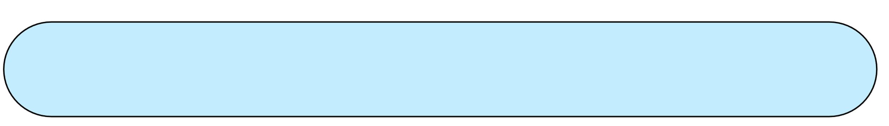
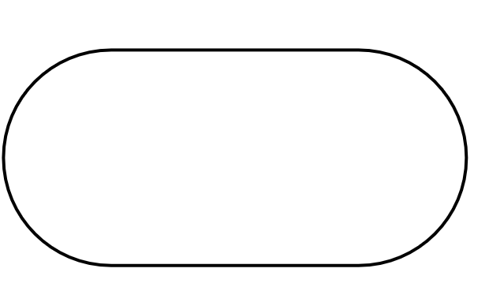

Team Members
COMPANY HAS TWO BRANCHES
Ahmed Samir Darwish
1
COMPANY
Ahmed Magdy Mustafa
2
Saif aleslam mohamed
3
Ahmed Ashraf Abdel aziz
4
Essam Elsayed Mahmoud
5
Eng. Amr Reda
Amer Mohamed Abdelhamed
6

Slide 2

Project overview
This is a network infrastructure of company which has two branches located at two different states.
Routers are using EIGRP Protocol for the communication.
Concepts which are used:
VLAN
SWITCHPORT ACCESS , TRUNK
ETHER CHANNAL
PORT SECURITY
STP
DHCP
EIGRP

Slide 3
